Slide 1
Literary Elements
English 2 PH

Slide 2
REVIEW
Setting is the time and place of the story
Character is someone or something that experiences events in the story; people OR personalities
- dynamic vs. static - round vs. flat -
- protagonist - antagonist
Characterization is the way the author presents the character’s personality
direct – direct description (by narrator/stage directions)
indirect (by the character’s speech, actions, etc.)
Theme is a moral/lesson of the story OR central idea/focus
Ex: Absolute power corrupts Ex. Corruption

Slide 3
REVIEW
Literature GENRES are categories of literary composition
Fiction – made up stories; unrealistic, fantasies
Non-fiction – true stories (biographies)
Drama – stories written to be performed on a stage
Poetry – “measured language of emotion”; writing in verse
Folk Literature – stories and legends passed down orally
Figurative Language is language that has meaning beyond the obvious/literal meaning (figures of speech)
Imagery – language that appeals to reader’s five senses
Foreshadowing – clues about future events in the story

Slide 4
IRONY (review)
Difference between expectation and reality
Technique that involves unusual, interesting, or amusing contradictions or contrasts
VERBAL irony – words suggest the opposite of their usual meaning
SITUATIONAL irony – an event occurs that directly contradicts expectations
DRAMATIC irony – the audience/reader knows something the character does not

Slide 5
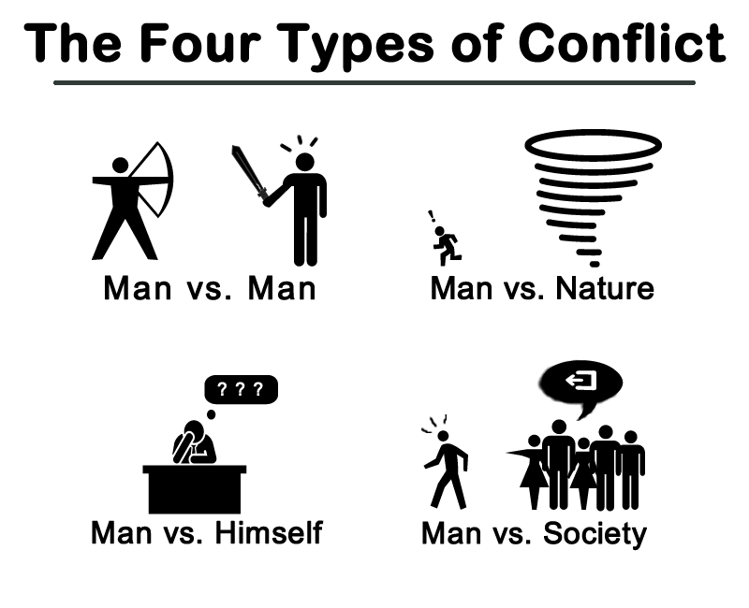
Conflict - problem or struggle between two opposing forces
Two TYPES:
Internal:
man vs. self
External
man vs. man
man vs. nature
man vs. society
*Others listed but not examined here:
Man vs. god
Man vs. technology
Man vs. supernatural

Slide 6
Plot – series of events that make up a story
Exposition: information the author gives the reader about setting, time, characters, etc. (a general introduction)
Rising Action: conflict is revealed, tension is built up (what happens between the introduction and the climax)
Climax: the high point, turning point, or point of interest in the story. The reader wonders if the conflict will be resolved and what will happen next.
Falling action: the events and complications begin to resolve themselves. Conflicts are solved.
Resolution/Denouement: anything that ties up loose ends or leaves a final thought for the reader.

Slide 7
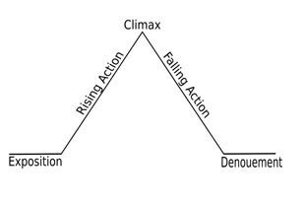
Plot
Flashback is an interruption of the chronological (time) order of events to present something that occurred before the beginning of the story.

Slide 8
Point of View
The mental perspective from which the story is told or narrated. There are THREE main POVs:
First person – the story is told by the character from his/her own perspective (“I”)
Second person – addresses the reader (rare, mostly in poetry and instructions & recipes)
Third person limited – the story is told by an outsider looking at the events, knowing the thoughts and feelings of only one character
Third person omniscient – again, someone else narrates, but knows the thoughts and feelings of almost every character

Slide 9
First Person

Slide 10
STYLE
The distinctive way that a writer uses language including such factors as diction (word choice), sentence length, arrangement, complexity, and the use of figurative language and imagery.
Allusion is a reference to something or someone the audiece is familiar with (or should know about)
Denotation is dictionary definition of the word (school = place of learning)
Connotation is words and ideas that are associated with the word (school = home or prison?); can be postitive or negative
Dialect is speech that reflects pronunciation, vocabulary, and grammar typical of a geographical region.

Slide 11
Which one would be said by an Englishman?

Slide 12
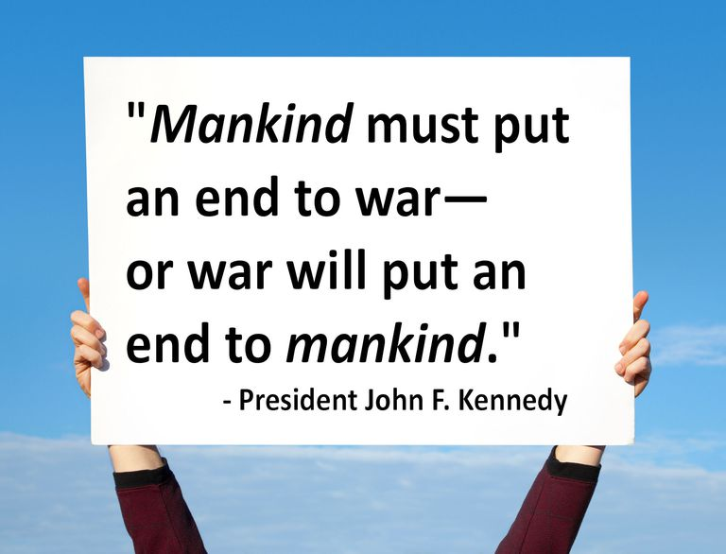
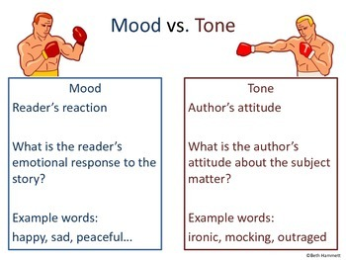
STYLE (continued)
Rhetoric is the study and use of effective speaking and writing (usually to persuade)
Tone is the author’s attitude towards the subject (in the article/poem/ literary work) – what the author feels
Mood is the overall atmosphere the author creates in the story (often w/diction) – what the reader/audience feels

