Slide 1
DRAMA TERMS
What are the essential components of drama?

Slide 2
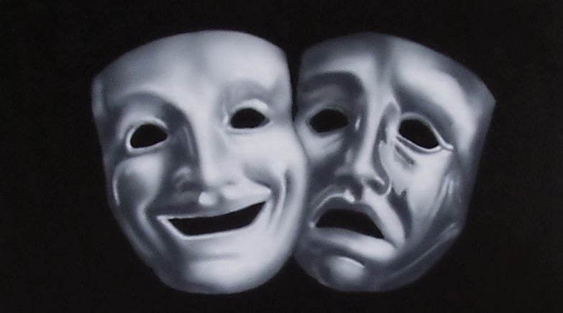
Drama Basics
Comedy – drama piece (play) that ends happily (usually in marriage)
Tragedy – drama piece, where the main character dies due to a tragic flaw (personal failing)
ex: Romeo

Slide 3
Drama Basics (continued)
Stage directions – specific instructions for the actors about the dialogue, setting, and action of a play (in brackets or parentheses and italicized)
Annotations – additional information provided by publisher/author/playwright that explains names, places, cultural facts (usually as footnotes)

Slide 4
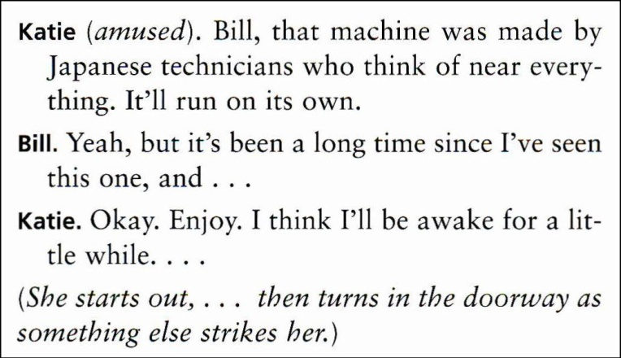
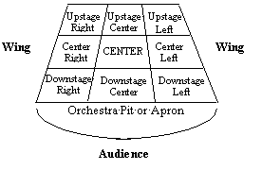
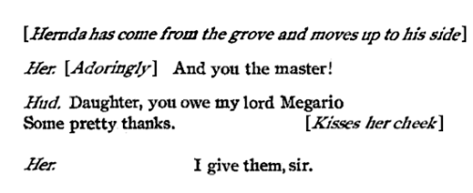

Slide 5
Sophoclean Tragedy & the Greek Theater
Plays were based on familiar stories/events
Tragic hero had a weakness (flaw) but did not always die → learned a lesson instead
Chorus served as a narrator, explained/
interpreted action, and entertained (no curtain in between scenes)
Later, Shakespearean drama (Renaissance) replaced “chorus” with “soliloquy”

Slide 6
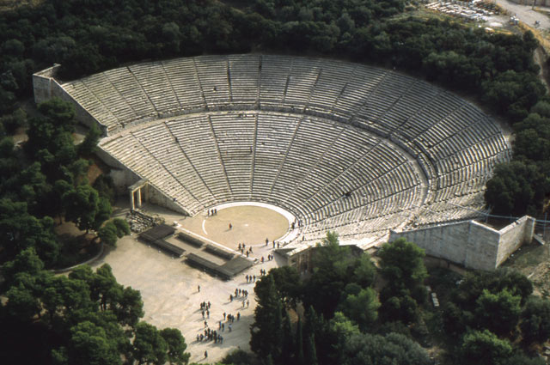

Slide 7
Drama Techniques
Aside – a short, personal remark only for the audience
Soliloquy – a character monologue intended for the audience ONLY (thinking out loud)
Monologue – a long speech done by a character with other character(s) listening
Apostrophe – when an inanimate object or absent person is addressed as if the person or object would respond

Slide 8
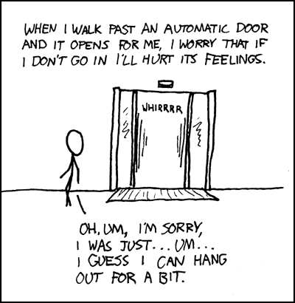

Slide 9
(More) Drama Terms
Foil – a character who serves the purpose of revealing the main character’s personality (usually by contrast)
Confidant(e) – a trusted friend for the main character (this one replaces the soliloquy during Realism)
Allusion – a reference to history, mythology, or literature to make a comparison. The author assumes audience is familiar with it.

Slide 10
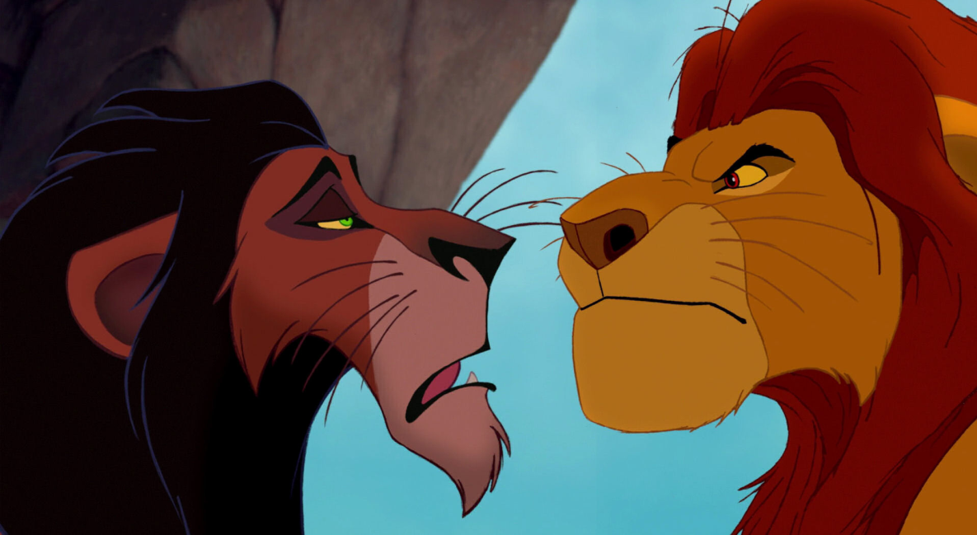
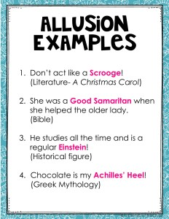
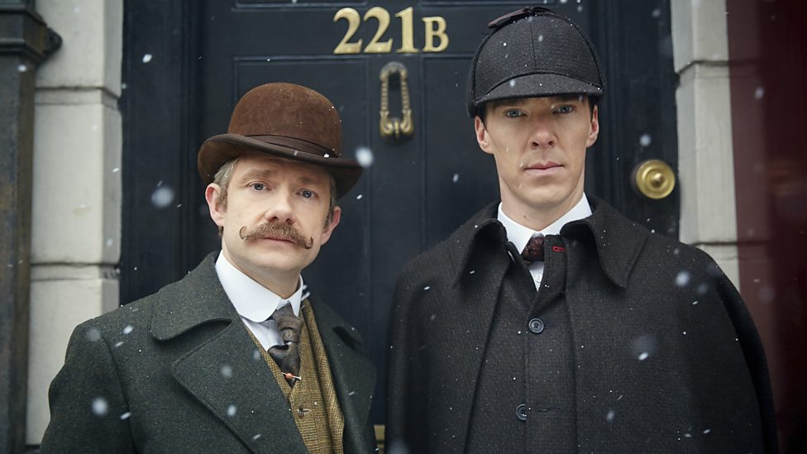

Slide 11
(review) Literary Terms
Symbol – an object or action that has meaning in itself (literal) but stands for something else, beyond itself.
Irony – difference between expectation and reality
Verbal – something is said that is not expected; sarcasm
Situational – something happens that is not expected
Dramatic – when audience/readers know something that characters do not
Characterization – the way the writer presents a character’s personality.
Direct – tells the audience what the personality of the character is directly.
Indirect – shows things that reveal the personality of a character through STEAL (speech, thoughts, effect on others, actions, looks)

Slide 12
