Slide 1
CYRANO’S WORLD
17th century life
in Europe presented by a 19th century writer
Realism meets Renaissance Era

Slide 2
Edmond rostand
He was born in 1868, France (19th century)
His wife was also a poet, but never became famous (in the shadow of her husband)
Most famous play Cyrano De Bergerac is loosely based on a real person, who lived in 17th century - he had an uncommon appearance and a strong character

Slide 3
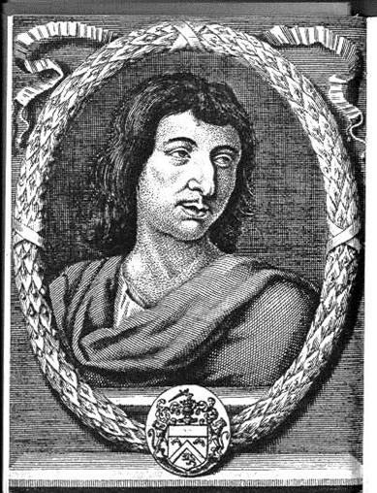
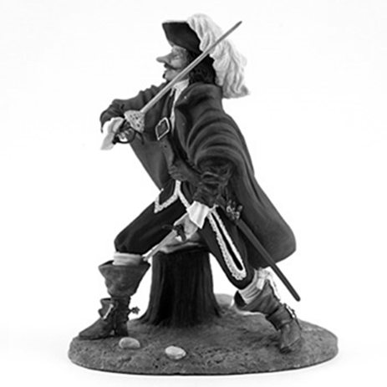

Slide 4
Entertainment
19th century
Purpose of DRAMA: to teach a lesson & to please
Less fantasy and supernatural → more REALISM
No more soliloquys → get a companion instead (confidante)
Simple sets for plays
Violence was placed offstage

Slide 5
Theater
17th century
Actors worked in groups called TROUPES
Income depended on success of the play
Plays were selected by a vote after the author read it to the troupe members
Roles were traditionally passed on from one actor to another (apprenticeship)
Actors prepared their own costumes

Slide 6
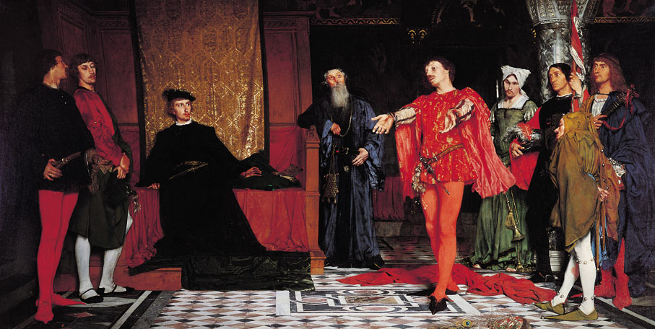

Slide 7
Gascon guards
17th century
They came from a French province, GASCONY
Gascons were mercenaries, proud and impetuous, mostly poor
Born and raised to fight in the army
Honored bravery and loyalty the most

Slide 8
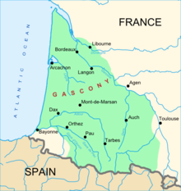
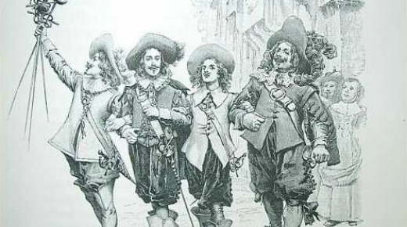
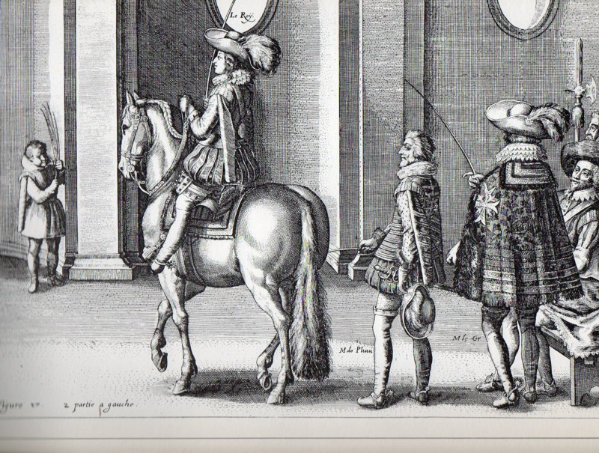
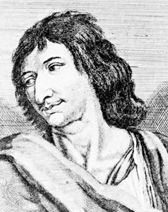

Slide 9
Poets & artists
17th century
Poetry & Art were valued by society
Poetry was ART!!!
Poets & Artists lived in the PRESENT (seize the day!) → who cares about tomorrow?
Looks and feelings mattered more than morality
Combination of gallantry & free-spiritedness

Slide 10
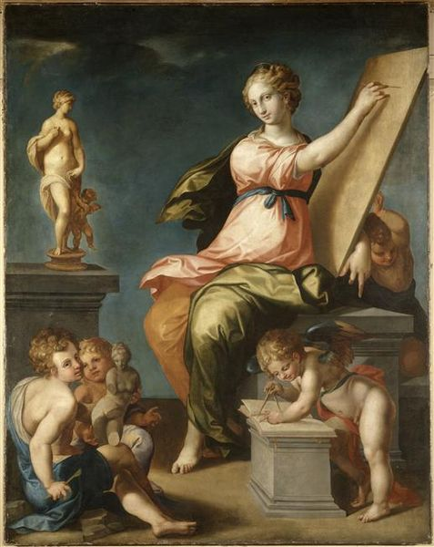

Slide 11
Role of women
17th century
Women were discouraged to speak their mind
They were expected to be beautiful (inspiration for artists)
A simple woman’s greatest calling was motherhood
Only upper class received education

Slide 12
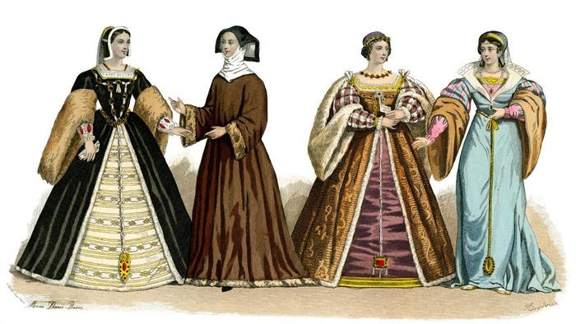

Slide 13
Romantic vs. deformed hero
17th century
HERO in a story was considered romantic when he was ideal: honorable, brave, handsome, intelligent
Physical deformity was associated with the devil
DEFORMED HERO needed a woman to love him despite his deformity → to become romantic

Slide 14
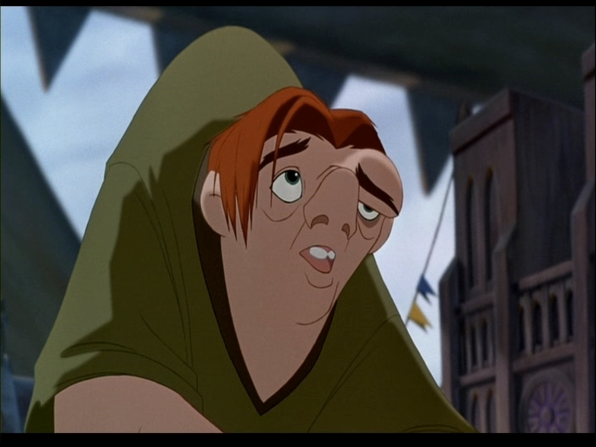
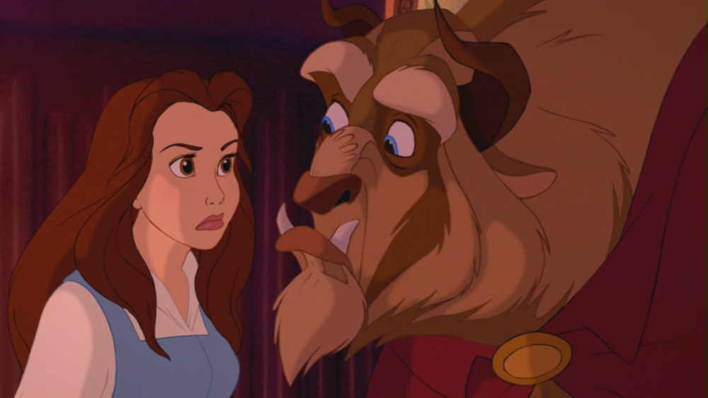

Slide 15
French academy
Originated around 1630s, to improve language, literature and the arts
Actors were not allowed to be members
It is still a powerful organization today!
Focuses on purifying the French language and culture

